Slide 1
Developing Belief Network:
Cognitive and Cultural Influences on Belief
Rebekah Richert, University of California, Riverside
Kathleen Corriveau, Boston University
https://developingbelief.com

Slide 2
Overview
The Developing Belief Network Is:
An international research network
Devoted to studying the development and diversity of belief
And to supporting cross-cultural research into human development
We Will Work Together to Study:
Initial studies will focus on religious thinking and behavior
Individual researchers can also pursue independent research questions
Once established, we will seek funding for questions of broad interest to developmental science

Slide 3
Research Questions

Slide 4
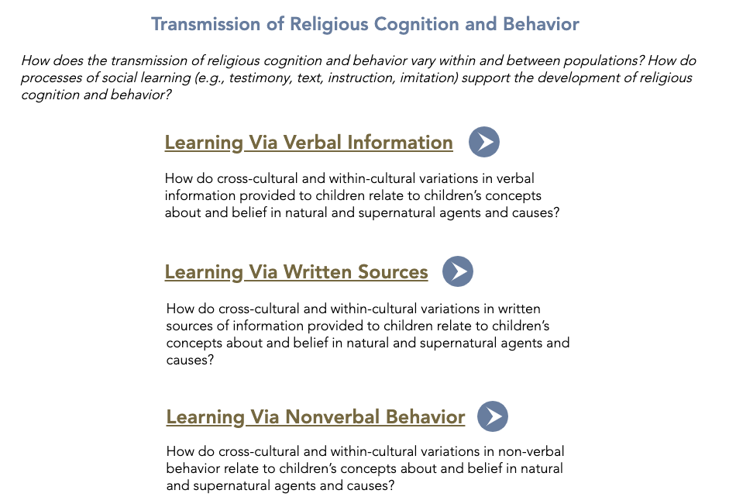
Research Questions

Slide 5
A Genuine Collaboration
Built on Principles of Open and Collaborative Science
​
Choosing Research Questions
Determining Methods
Measure Validation
Building a Data Set
Dissemination

Slide 6
The Mechanics
Will award approx. $4 mil in large grants
Will fund 8-10 Large Grant Proposals
Maximum budget = $500K
5-year commitment
Year 1
(6/1/2020 - 5/31/2021)
Year 2
(6/1/2021 - 5/31/2022)
Spring 2020
Call for proposals to join network
​
Summer 2020
Selected researchers invited to join network
​
Fall 2020
Kick-off workshop to finalize collaborative research questions and tasks
​
Winter 2021
Translation, back-translation, and revision of tasks to be culturally-relevant
Spring 2021
Collaborative method validated & piloted at research sites
​
Summer 2021
Collaborative method validated & piloted at research sites
​
Fall 2021
Collaborative method validated & piloted at research sites; revisions to tasks and methods as necessary
​
Winter 2022
Full network meeting

Slide 7
The Mechanics
Year 3
(6/1/2022 - 5/31/2023)
Year 4
(6/1/2023 - 5/31/2024)
Year 5
(6/1/2024 - 5/31/2025)
Spring 2022
First round of collaborative data collection at all sites
​
Summer 2022
First round of collaborative data collection at all sites
​
Fall 2022
First round of collaborative data collection at all sites
​
Winter 2023
Full meeting with network
Spring 2023
Second round of data collection
at all sites
​
Summer 2023
Second round of data collection
at all sites
​
Fall 2023
Second round of data collection
at all sites
​
Winter 2024
Full network meeting
Spring 2024
Third round of data collection
​
Summer 2024
Third round of data collection
​
Fall 2024
Third round of data collection
​
Winter 2025
Full network meeting

Slide 8
Funding & Support
Members of the Developing Belief Network Will Benefit from an Extensive and Supportive Infrastructure
Strategic thinking & support for data collection in sites,
Data cleaning, sharing, mining
Translation and coding,
Remote training of project staff
Repository for data

Slide 9
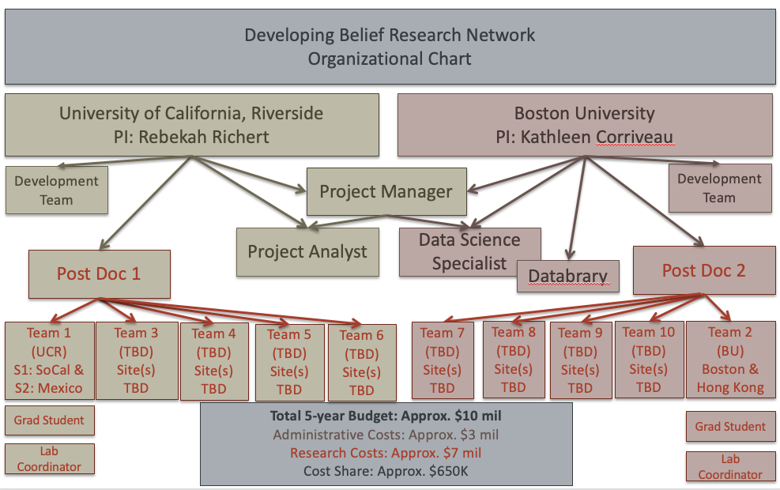
Organizational Structure

Slide 10
PIs & Advisory Board
PIs:
Dr. Rebekah Richert (University of California, Riverside)
Dr. Kathleen Corriveau (Boston University)
Advisory Board:
Dr. Karen Adolph (New York University)
Dr. Maureen Callanan (University of California, Santa Cruz)
Dr. Rick Gilmore (Pennsylvania State University)
Dr. Paul Harris (Harvard University)
Dr. Deborah Kelemen (Boston University)

Slide 11
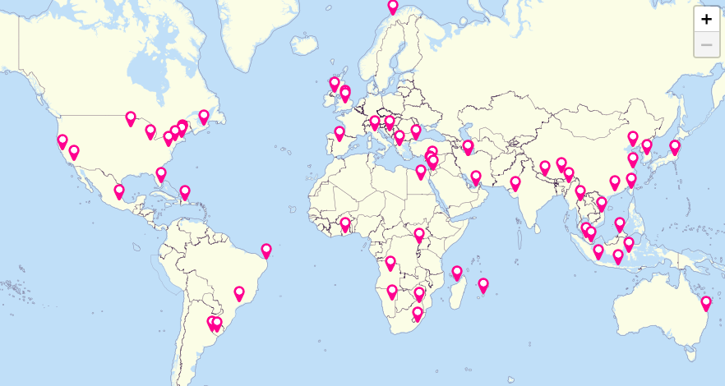
Letters of Interest
Due March 15, 2020
38 LOIs, representing 97 individual researchers, & research sites in 47 countries

Slide 12
Developing Belief Network:
Cognitive and Cultural Influences on Belief
Rebekah Richert, University of California, Riverside
Kathleen Corriveau, Boston University
https://developingbelief.com

